Slide 1
decentralization [consensus strategies + incentives]

Slide 2
Distributing scroogecoin
concerns
who maintains ledger?
who decides which transactions are valid?
who creates new bitcoins?
who determines rules of system?
how do bitcoins acquire exchange value?
Byzantine Generals problem
practical vs. theoretical gains
incentives
probabilistic notion of consensus
Notes:
-for Bitcoin, we have consensus that works in practice, but we still don’t have a theory for it
-theory necessary for predictions, confidence, guarantees, etc.
-probability that network converges with time gets higher and higher
-if nodes had identities, it would be easier to get consensus (decentralized system – who assigns identities)
-run a lottery to pick a random node in the system which decides consensus – the Sybil problem
-Sybils should not get extra picks

Slide 3
Consensus in bitcoin
target: synchronized global ledger
sol: nodes propose blocks at regular intervals
problems:
nodes may crash
connectivity may be poor
network latency
malicious nodes

Slide 4
Consensus in bitcoin
a simplified consensus algorithm:
new transactions are broadcast to all nodes
each node creates a block
in each round, a random node is picked to broadcast its block
other nodes accept block only if transactions in it are valid
nodes express their acceptance of the block by including its hash in the next block they create
Notes:
-valid transactions are those which are unspent and have valid signatures
-can Alice steal bitcoins belonging to another user?
No. Even if Alice is picked to propose the next block, she cant create a valid transaction to spend those coins.
-DoS attack? Censorship?
If Alice excludes Bob’s transaction from block, he just waits until an honest user is picked to propose the next block. Minor annoyance.
-can Alice double-spend?

Slide 5
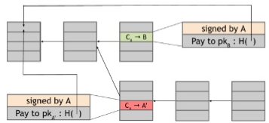
Double spend attack
Bob is a merchant
Alice purchases item from Bob
Bob sees corresponding transaction in block chain
Bob gives item to Alice
Alice gets to propose next block
Alice ignores previous block
Alice includes transaction in her block sending those coins to another address
earlier transaction is useless
6 confirmations standard
Notes:
-will double-spend work? We don’t know – both transactions are cryptographically valid!
-moral dimension only becomes clear when one knows the story
-concept of tainted coins
-Alice could even bribe the party which chooses the next block
-block containing Bob’s transaction is rejected – ‘orphan’ block
-orphan blocks may arise for a variety of reasons:
May contain invalid transaction or double spend attempt
May be result of network latency
Blocks may be simultaneously discovered and one will obviously be orphaned
-cautious merchant would wait a bit after Alice circulates transaction; that way he could catch Alice undertake double-spend attack
-honest nodes always extend longest valid branch that they find
-probability of another branch overtaking the original one becomes exponentially small with every confirmation
-however, no 100% probability!
-6 confirmations – 1 hr!

Slide 6
incentives
notion of honesty
punishment
how to punish?
rewards
how to reward?
two types of rewards
block reward
special transaction
coin-creation transaction
halves after every 4 years
validity of reward?
transaction fees
outputs < inputs
Notes:
-we saw how consensus works – and we *think* it is secure
-second component – incentives
-who to punish? how do we know which transaction is dishonest – moral issues
-cant punish dishonest nodes – they don’t have identities!
-incentives in real life – punishment vs. incentive

Slide 7
Proof of work
Identities and sybils
defeat monopoly
computing power
hash puzzles
H(nonce||prev_hash||tx||tx||…||tx) < target
target space
brute force
completely decentralized
Notes:
-physical analogy – dummies cannot do physical work!
-prev_hash is *not* hash pointer in this case, as in, it does not act as address
-rather hash value acts as identifier (when requesting from other parties) and enables integrity check
-variable element here is the nonce – under miner’s control – everything else is fixed
-what else can you change to get variation? ordering of transactions
-completely decentralized as in no one has to pick which node gets to propose the next block

Slide 8
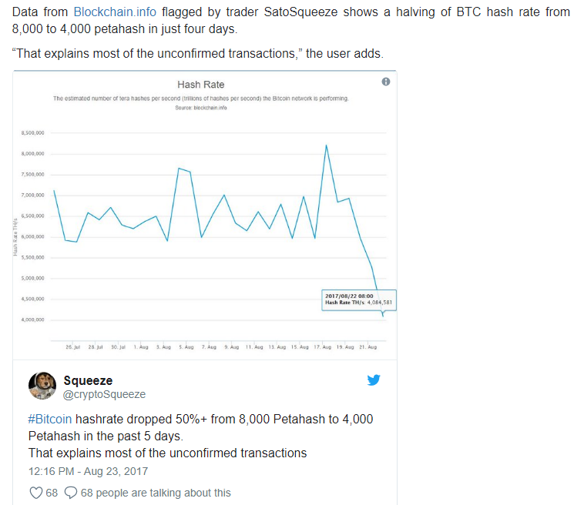
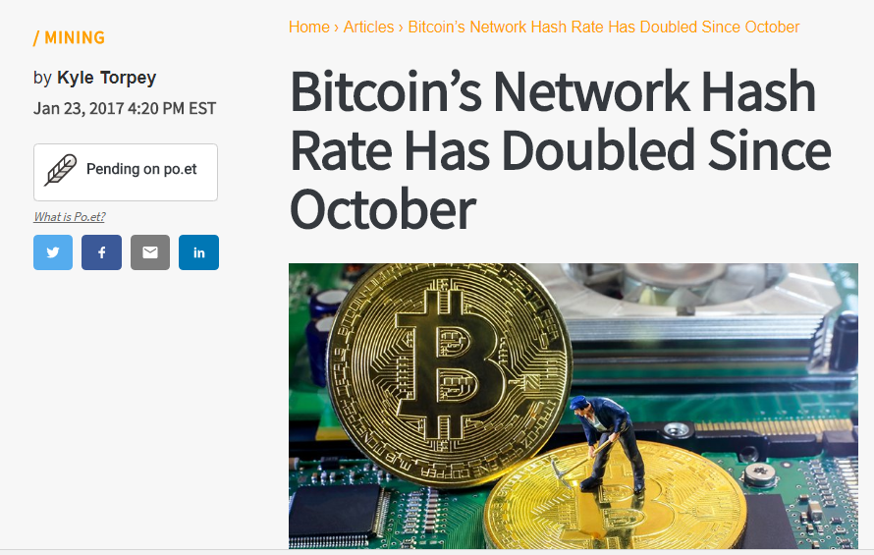
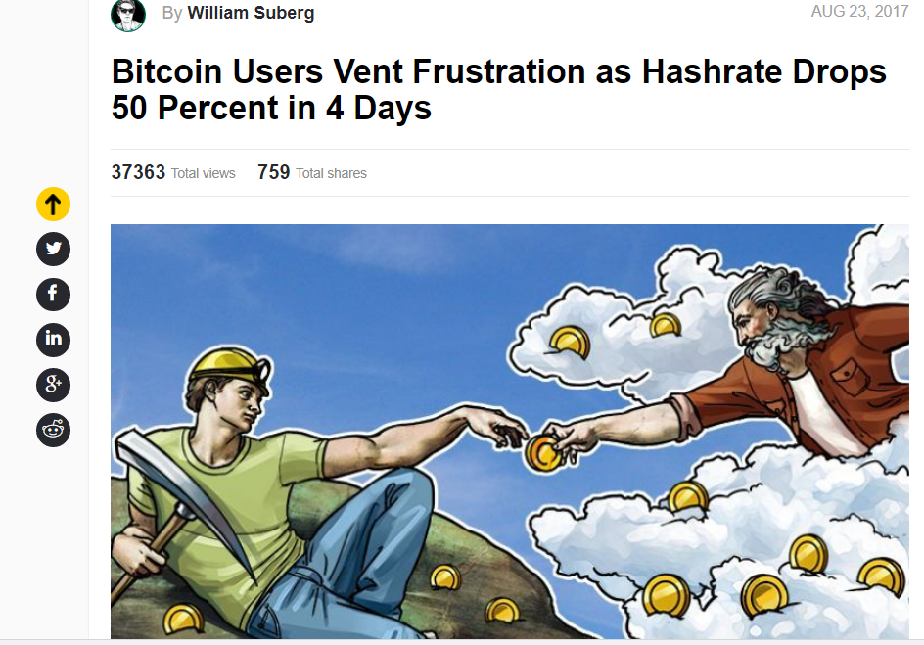
Proof of work
difficult to compute, trivial to verify
network hash rate (link)
Notes:
-why do folks ‘vent frustration’ when hashrate drops?

Slide 9
Proof of work
parametrizable
recalculation
2016 blocks
miners are not independent
probability
why 10 minutes?
If most miners, weighted by hash power, are honest, then there is at least a 50% chance that the next block is proposed by an honest node
Notes:
-approximately every 2 weeks!
-if you buy a rig, your returns depend on what other miners are doing
-if you have 0.1 percent of total hash power, you will find roughly 1 in every 1000 blocks
-10 minutes is not a magical number – interval should be decent enough to optimize advantage of packing transactions into blocks
-trivial to verify – nonce is part of the block – it takes 10^20 hash tries to find the right nonce but just one to verify it – again, no centralization needed here
-three important properties of proof of work function:
Difficult to compute
Parametrizable
Trivial to verify

Slide 10
mining
mining reward > mining cost
mining reward = block reward + tx fees
mining cost = hardware cost + operating costs
operating costs – electricity, cooling, etc.
fixed costs: hardware
variable costs: electricity
reward depends on ratio of hash rate to global rate
reward depends on exchange rate

Slide 11
High level picture
tricky interplay
security of blockchain
health of the mining ecosystem
value of the currency
bootstrapping problem
media attention
mining investment
alt-coin challenge
Notes:
-each factor depends on the other
-early days none of these properties were assured

Slide 12
Majority attack
51% attacker
coin theft?
invalid transaction?
purchase with invalid funds?
censor transactions
change block reward?
destroy confidence in Bitcoin?
Notes:
-attacker controls majority of mining power
-cant steal coins – you need the keys for that
-attacker builds chain with block containing an invalid transaction – other nodes will reject it, network will fork
-longest branch vs. invalid branch!
-Bob is an honest merchant – if he gets funds from a branch that is invalid, he will reject it
-attacker can suppress transactions appearing in blockchain to an extent
By not including them in his blocks
By rejecting blocks which include those transactions
-but transactions will still be circulated throughout network

Slide 13
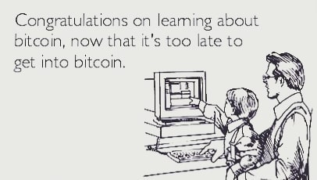
humor

Slide 14
Homework
Chap 2: How Bitcoin achieves decentralization Bitcoin and Cryptocurrency Technologies: A Comprehensive Introduction
Is Bitcoin a decentralized currency (link)
Bitcoin: Difficulty (link)(link)
Further reading
The Dogecoin story (link)(link)
Map of Bitcoin nodes (link)
Peter Todd double-spends Coinbase (link)
The Economics of Cryptocurrency Pump & Dump Schemes (study)(article)

